Slide 1
ICDL Data Analytics - Foundation
Syllabus 1.0
Training
MS Excel 2016 and MS Power BI
3 - Data Set Summarisation
Lessons 6-9
<insert Name of Presenter>
Notes:
Instructor notes:
This presentation is a resource for instructors designed to be used in conjunction with the ICDL Data Analytics – Foundation Learning Materials. There are references in the notes on each slide to the relevant lesson in the learning materials.
There is a course outline document that can be modified and shared with participants in advance of the training. See ICDL Data Analytics - Foundation1.0_course_outline.docx.
Note: Lesson 12-Creating Additional Data Visualizations goes beyond the ICDL Data Analytics – Foundation syllabus by providing additional skills that learners may find useful when creating reports. Whether trainers cover the content in this lesson will depend on factors such as the learner’s abilities and the training schedule.
There are notes provided in the slides to give high level guidance / directions for the instructor on the content that needs to be covered in the slides.
Instructors will need to localise and tailor the presentation to suit the needs of their audience and local market. For example:
Modify the content to use applications that are relevant for your audience/local market. The applications referenced in the practical lessons here are:
Microsoft Excel 2016
Microsoft Power BI Desktop
Microsoft Power BI Service
Modify the content to use examples and scenarios that are relevant for your audience/local market.
Modify the content to suit your audience’s understanding of the subject matter. For example, provide additional explanations or introductory information if needed or focus on more advanced content as relevant.
Modify the content to suit your teaching, learning and assessment strategy.
Practical content: The instructor should decide the best approach to this for their audience. For example, they may choose to demonstrate practical steps in the relevant tool and facilitate learners practicing the steps after a demonstration. Or they may facilitate learners trying the steps themselves in the relevant tool without a demonstration.
Note: Where possible the steps to complete a discrete task have been included on one slide to allow learners refer to the steps on a shared screen while completing the steps on an individual computer.
Review exercises: These are provided at the end of each lesson in the learning materials and are designed to allow the learners to reinforce their newly acquired knowledge and skills through practice. Modify and develop additional/new review exercises as required to suit your audience.
Resources: Include additional resources such as videos, animations, images, statistics, cheat sheets etc. relevant to your audience as required.

Slide 2

3 - Data Set Summarisation
Agenda
Lesson 6 – Pivot Table Data Aggregation
Lesson 7 – Pivot Table Frequency Analysis
Lesson 8 – Filtering Pivot Tables
Lesson 9 – Pivot Charts
Notes:
Instructor notes:
Outline the agenda

Slide 3

3 - Data Set Summarisation
Learning Objectives Overview
After completing these lessons, you should be able to:
Summarise data sets using pivot tables.
Summarise data sets using pivot charts.
Notes:
Instructor notes:
Review session/category level learning objectives

Slide 4
Pivot Table Data Aggregation
Lesson 6

Slide 5
6 – Pivot Table Data Aggregation
Learning Objectives
After completing this lesson, you should be able to:
Change the method of aggregation for a value
Display multiple aggregation values
Use built-in calculations
Notes:
Instructor notes:
Review Lesson Leaning Objectives

Slide 6

6 – Pivot Table Data Aggregation
Concepts: Changing Aggregation Methods
A pivot table presents a summary of the underlying data by applying summary functions (aggregation methods) to the data.
The summary functions are:
Sum | The sum of values. (Default for adding numerical values.)
Count | The number of values. (Default for counting entries in number fields.)
Average | The average (mean) of values.
Max | The largest value.
Min | The lowest value.
Notes:
Instructor notes:
Cover content in learning materials
References:
ICDL Data Analytics - Foundation 1.0 (6.2 Changing Aggregation Methods)
Further Resources:

Slide 7

6 – Pivot Table Data Aggregation
Task: Change the method of aggregation for a value to sum, average, count, minimum, or maximum.
Example: Show the average amount of credit card transactions for each department formatted as dollars with no decimal places.
Steps:
Open Cards Pivot.xlsx and go to the Pivot1 worksheet.
Click any value in the Sum of Amount item in the PivotTable.
On the Analyze tab, in the Active Field group, click Field Settings.
Select the function Average in the Summarize value field by list box.
Click in the Custom Name text box and type Average Amount.
Click Number Format.
Select Currency and set the Decimal places to 0.
Click OK.
Click OK.
Notes:
Instructor notes:
Cover content in learning materials
References:
ICDL Data Analytics - Foundation 1.0 (6.2 Changing Aggregation Methods)
Further Resources:

Slide 8
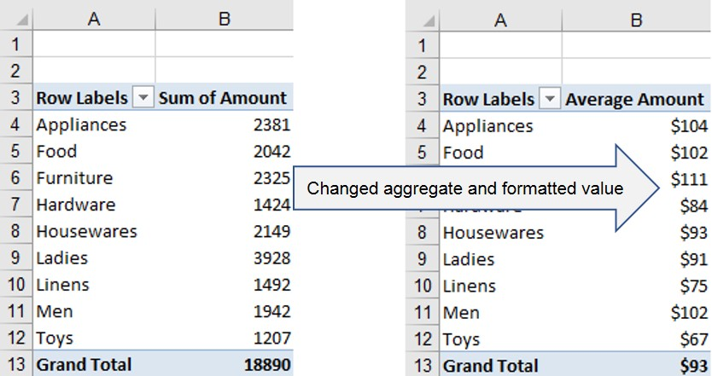
6 – Pivot Table Data Aggregation
Task: Change the method of aggregation for a value to sum, average, count, minimum, or maximum.
Example: Show the average amount of credit card transactions for each department formatted as dollars with no decimal places.
Result:
Original and Formatted Aggregate Value
Notes:
Instructor notes:
Cover content in learning materials
References:
ICDL Data Analytics - Foundation 1.0 (6.2 Changing Aggregation Methods)
Further Resources:

Slide 9


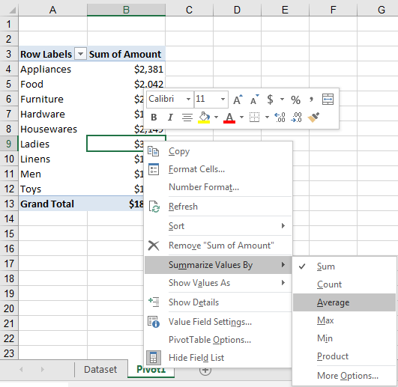
6 – Pivot Table Data Aggregation
Task: Change the method of aggregation for a value to sum, average, count, minimum, or maximum.
An alternative way to switch quickly between aggregation methods is
to
Right-click a value field
Choose Summarize Values By
Select a function.
Notes:
Instructor notes:
Cover content in learning materials
References:
ICDL Data Analytics - Foundation 1.0 (6.2 Changing Aggregation Methods)
Further Resources:

Slide 10
6 – Pivot Table Data Aggregation
Task: Display multiple aggregation values.
Example: Show the sum and total number of transactions, the highest and lowest transaction for each department.
Steps:
Open Cards Pivot.xlsx and go to Pivot2 worksheet.
Click any cell in the PivotTable.
Drag and drop Amount, Trans #, Amount, Amount fields into the Σ Values area.
Right click the field Sum of Amount2.
Select Summarize Values By and select Max.
Right click the field Sum of Amount3.
Select Summarize Values By and select Min.
Right click a field, select Value Field Settings, and change the name in the Custom Name text box as follows:
Sum of Amount to Total Count of Trans# to Transactions Max of Amount2 to Highest Min of Amount3 to Lowest
Notes:
Instructor notes:
Cover content in learning materials
References:
ICDL Data Analytics - Foundation 1.0 (6.3 Displaying Multiple Aggregation Values)
Further Resources:

Slide 11
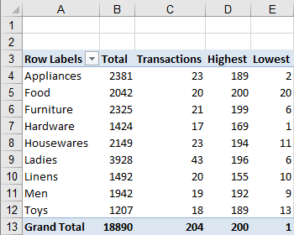
6 – Pivot Table Data Aggregation
Task: Display multiple aggregation values.
Example: Show the sum of the transactions, the total number of transactions, the highest transaction and the lowest transaction For each department.
Result:
Labelled Multiple Aggregation Values
Notes:
Instructor notes:
Cover content in learning materials
References:
ICDL Data Analytics - Foundation 1.0 (6.3 Displaying Multiple Aggregation Values)
Further Resources:

Slide 12
6 – Pivot Table Data Aggregation
Concepts: Using built-in calculations to display values as: % calculation, difference from specific values, running total, ranked.
The PivotTable command contains built-in calculations, also known as custom calculations, which you can use to display values in different ways, such as:
  Percentage calculations
  Difference from specific values
  Running totals
  Ranked
This functionality is provided in the Show Value As option.
Notes:
Instructor notes:
Cover content in learning materials
References:
ICDL Data Analytics - Foundation 1.0 (6.4 Using Built-in Calculations)
Further Resources:

Slide 13
6 – Pivot Table Data Aggregation
 | Show Value As Option | Description
1. Percentage Calculations | % of Grand Total | Displays values as a percentage of the grand total of all the values.
 | % of Column Total | Displays all the values in each column or series as a percentage of the total for the column or series.
 | % of Row Total | Displays the value in each row or category as a percentage of the total for the row or category.
 | % Difference From | Displays values as a percentage of the difference between two values.
2. Difference from | Difference From | Displays values as the difference between two values.
3. Running Totals | Running Total in | Displays cumulative or running totals of pivot table cell values.
4. Ranked | Rank Smallest to Largest | Displays the rank of selected values in a specific field from smallest to largest, listing the smallest item in the field as 1, and each larger value with a higher rank value.
 | Rank Largest to Smallest | Displays the rank of selected values in a specific field, listing the largest item in the field as 1, and each smaller value with a higher rank value.
Notes:
Instructor notes:
Cover content in learning materials
References:
ICDL Data Analytics - Foundation 1.0 (6.4 Using Built-in Calculations)
Further Resources:

Slide 14
6 – Pivot Table Data Aggregation
Task: Display values as: % calculation.
Example: Show the amount for each department as a percentage of the Grand Total.
Steps:
Open Cards Pivot.xlsx and go to the Pivot3 worksheet.
Click any value in the Sum of Amount item in the PivotTable.
On the Analyze tab, in the Active Field group, click Field Settings.
Select the Show Values As tab in the Value Field Settings dialog.
Click Show values as drop-down list and select % of Grand Total.
Type Percentage in the Custom Name box.
Click Number Format.
Select the Percentage category and set the Decimal places to 1.
Click OK to close the Format Cells dialog box.
Click OK to close the Value Field Settings dialog box.
Notes:
Instructor notes:
Cover content in learning materials
References:
ICDL Data Analytics - Foundation 1.0 (6.4 Using Built-in Calculations)
Further Resources:

Slide 15
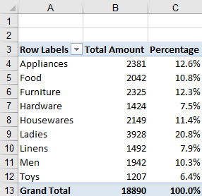
6 – Pivot Table Data Aggregation
Task: Display values as: % calculation.
Example: Show the amount for each department as a percentage of the Grand Total.
Result:
Notes:
Instructor notes:
Cover content in learning materials
References:
ICDL Data Analytics - Foundation 1.0 (6.4 Using Built-in Calculations)
Further Resources:

Slide 16
6 – Pivot Table Data Aggregation
Task: Display values as: ranked.
Example: Show the number of transactions for each department ranked from highest to lowest (highest value ranked as 1).
Steps:
Click any value in the Count of Trans # item in PivotTable in Pivot3 in Cards Pivot.xlxs.
On the Analyze tab, in the Active Field group, click Field Settings.
Select Show Values As tab in Value Field Settings dialog.
Click Show values as drop-down and Rank Largest to Smallest.
Type Rank in the Custom Name box to modify the name.
Click OK.
Notes:
Instructor notes:
Cover content in learning materials
References:
ICDL Data Analytics - Foundation 1.0 (6.4 Using Built-in Calculations)
Further Resources:

Slide 17
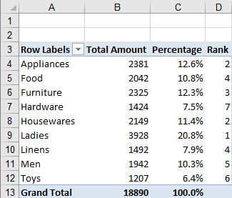
6 – Pivot Table Data Aggregation
Task: Display values as: ranked.
Example: Show the number of transactions for each department ranked from highest to lowest (highest value ranked as 1).
Result:
Number of Transactions Ranked from Highest to Lowest
Notes:
Instructor notes:
Cover content in learning materials
References:
ICDL Data Analytics - Foundation 1.0 (6.4 Using Built-in Calculations)
Further Resources:

Slide 18
6 – Pivot Table Data Aggregation
Task: Display values as: running total.
Example: Show the cumulative daily total.
Steps:
Go to Pivot4 worksheet.
Click any cell in the PivotTable.
Drag and drop the Amount field into the Σ Values area.
Click any value in the Sum of Amount item in the PivotTable.
On Analyze tab, in the Active Field group, click Field Settings.
Select Show Values As tab in the Value Field Settings dialog.
Click Show values as drop-down and Running Total In.
Ensure Date is set as the Base field.
Type Cumulative Total in the Custom Name box.
Click OK.
Notes:
Instructor notes:
Cover content in learning materials
References:
ICDL Data Analytics - Foundation 1.0 (6.4 Using Built-in Calculations)
Further Resources:

Slide 19
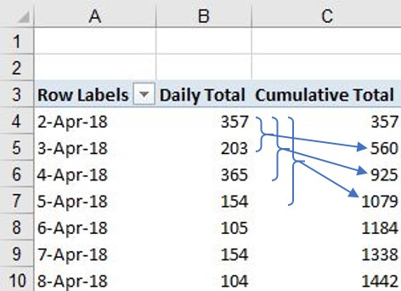
6 – Pivot Table Data Aggregation
Task: Display values as: running total.
Example: Show the cumulative daily total
Result:
Cumulative Daily Total
Notes:
Instructor notes:
Cover content in learning materials
References:
ICDL Data Analytics - Foundation 1.0 (6.4 Using Built-in Calculations)
Further Resources:

Slide 20
6 – Pivot Table Data Aggregation
Task: Display values as: difference from specific values.
Example: Show the difference between the total amount of Visa card transactions and the other card types using the Difference From calculation.
Steps:
Go to Pivot5 worksheet.
Click any cell in the PivotTable.
Drag and drop the Amount field into the Σ Values area.
Click any value in the Sum of Amount item in the PivotTable.
On Analyze tab, in the Active Field group, click Field Settings.
Select Show Values As tab in the Value Field Settings dialog.
Click Show values as drop-down and select Difference From.
Ensure Payment Type is selected in the Base field list box.
Select Visa in the Base item list.
Type Difference in the Custom Name box
Click OK.
Notes:
Instructor notes:
Cover content in learning materials
References:
ICDL Data Analytics - Foundation 1.0 (6.4 Using Built-in Calculations)
Further Resources:

Slide 21
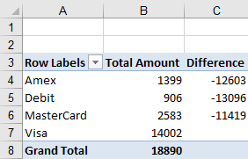
6 – Pivot Table Data Aggregation
Task: Display values as: difference from specific values.
Example: Show the difference between the total amount of Visa card transactions and the other card types using the Difference From calculation.
Result:
To see the percentage
difference, use %
Difference From.
The percentage change figure is useful for analysing trend data.
Comparing Differences between Visa and Other Card Payments
Notes:
Instructor notes:
Cover content in learning materials
References:
ICDL Data Analytics - Foundation 1.0 (6.4 Using Built-in Calculations)
Further Resources:

Slide 22
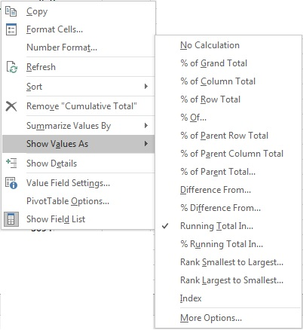
6 – Pivot Table Data Aggregation
Task: Display values as: % calculation, difference from specific values, running total, ranked.
An alternative way to switch quickly between the various built-in calculations is to
Right-click a value field.
Choose Show Values As.
Select a calculation.
Notes:
Instructor notes:
Cover content in learning materials
References:
ICDL Data Analytics - Foundation 1.0 (6.4 Using Built-in Calculations)
Further Resources:

Slide 23


6 – Pivot Table Data Aggregation
Learning Objectives Review
You should now be able to:
Change the method of aggregation for a value
Display multiple aggregation values
Use built-in calculations
Notes:
Instructor Notes:
Review learning objectives

Slide 24

6 – Pivot Table Data Aggregation
Review Exercise
Notes:
Instructor notes:
Ask participants to complete the Review Exercise to review their knowledge and practice their skills and support them as required.
They will need access to Excel 2016
Review answers with the group
Question answers
1 - 13 (see Aggregate-Solution.xlsx)
References:
ICDL Data Analytics - Foundation 1.0 (6.5 Review Exercise - page 87)
Relevant workfiles in Student folder (Aggregate.xlsx and solution file Aggregate-Solution.xlsx)

Slide 25
Pivot Table frequency Analysis
Lesson 7

Slide 26
7 – Pivot Table Frequency Analysis
Learning Objectives
After completing this lesson, you should be able to:
Automatically group date, time and numeric data items
Manually create custom groups
Rename groups
Ungroup data items
Notes:
Instructor Notes:
Review learning objectives

Slide 27
7 – Pivot Table Frequency Analysis
Concepts: Grouping date, Time and Numeric Data
You can organize data in pivot tables into groups to help find patterns and trends in the data.
Date and Time Data
  Date and time fields can be grouped by seconds, minutes, hours, day, month, quarter, or year.
  Date and time fields can also be grouped into hierarchical groups, for example by week and day or by year and quarter.
Numeric Data
  Numeric values can be grouped by specified intervals
Notes:
Instructor notes:
Cover content in learning materials
References:
ICDL Data Analytics - Foundation 1.0 (7.1 Grouping Date, Time and Numeric Data)
Further Resources:

Slide 28
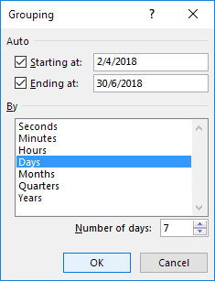
7 – Pivot Table Frequency Analysis
Task: Automatically group data.
Example: Group data by week.
Steps:
In Cards Group.xlsx go to Group1 worksheet.
Click any date value below Row Labels.
On Analyze tab, in the Group group, click Group Field
In the Grouping dialog box, in the By list box, deselect the Months option, select Days and type 7 in the Number of Days box.
Click OK.
By default, the Starting at and Ending at dates are the first and last dates in the pivot table.
Grouping by a Week
Notes:
Instructor notes:
Cover content in learning materials
References:
ICDL Data Analytics - Foundation 1.0 (7.1 Grouping Date, Time and Numeric Data)
Further Resources:

Slide 29
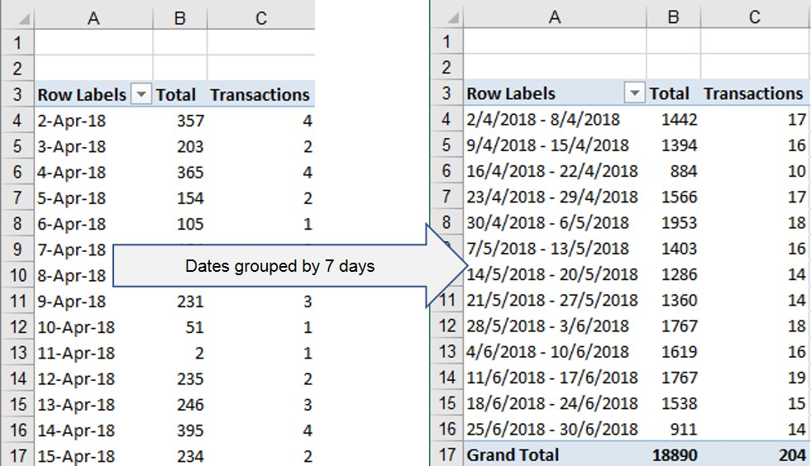
7 – Pivot Table Frequency Analysis
Task: Automatically group data.
Example: Group data by week.
Result:
The daily report is presented as a weekly report in the Pivot Table.
Notes:
Instructor notes:
Cover content in learning materials
References:
ICDL Data Analytics - Foundation 1.0 (7.1 Grouping Date, Time and Numeric Data)
Further Resources:

Slide 30
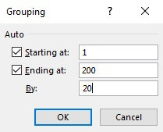
7 – Pivot Table Frequency Analysis
Task: Automatically group data.
Example: Group data by intervals of 20.
Steps:
In Cards Group.xlsx go to Group2.
Click any numerical value in the Rows area.
On the Analyze tab, in the Group group, click Group Field.
In the Grouping dialog box, in the By text box, type 20 and click OK.
By default, starting and ending values are the lowest and highest values in the pivot table.
Grouping Numbers
Notes:
Instructor notes:
Cover content in learning materials
References:
ICDL Data Analytics - Foundation 1.0 (7.1 Grouping Date, Time and Numeric Data)
Further Resources:

Slide 31
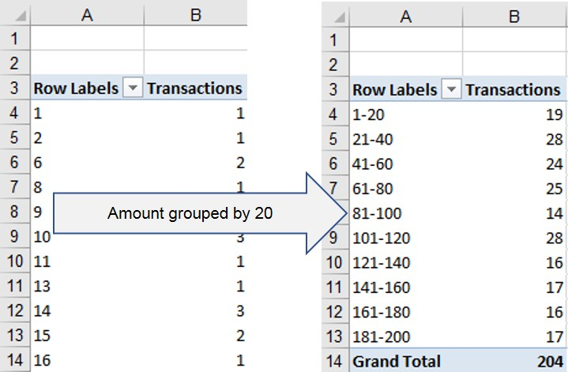
7 – Pivot Table Frequency Analysis
Task: Automatically group data.
Example: Group data by intervals of 20.
Result:
Amount Values Grouped by 20
Notes:
Instructor notes:
Cover content in learning materials
References:
ICDL Data Analytics - Foundation 1.0 (7.1 Grouping Date, Time and Numeric Data)
Further Resources:

Slide 32
7 – Pivot Table Frequency Analysis
Task: Manually create custom groups
Example: Group a list of banks by country groups.
Steps:
In Cards Group.xlsx go to Group3.
Select these items to group:
  American Express
  Bank of America
  CapitalOne
  Chase Manhattan
  CitiBank
  Seattle FirstBank
  Wells Fargo
On the Analyze tab, in the Group group, click Group Selection.
Repeat for the following:
  Bank of Montreal
  ScotiaBank
  Toronto Dominion Bank
  VanCity Credit Union
Repeat for the following:
  Lloyds Banking Group
  Santandar
  Santandar of Scotland
Click on Group1 and type USA
Click on Group2 and type Canada
Click on Group3 and type Other.
Notes:
Instructor notes:
Cover content in learning materials
References:
ICDL Data Analytics - Foundation 1.0 (7.2 Creating Custom Groups)
Further Resources:

Slide 33
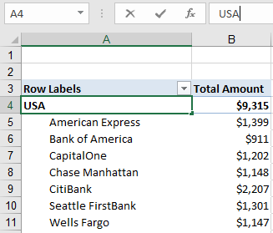
7 – Pivot Table Frequency Analysis
Task: Manually create custom groups
Example: Group a list of banks by country groups.
Result:
USA group
Notes:
Instructor notes:
Cover content in learning materials
References:
ICDL Data Analytics - Foundation 1.0 (7.2 Creating Custom Groups)
Further Resources:

Slide 34

7 – Pivot Table Frequency Analysis
Task: Ungroup Data
Example: Ungroup a list of banks by country groups.
Steps:
Go to the grouped pivot table in the Group3 worksheet in Cards Group.xlsx workbook.
Select the country label USA.
On the Analyze tab, in the Group group, click Ungroup to show the original data.
Repeat for the Canada and Other group.
Alternatively, you can right-click a group label and select Ungroup.
Notes:
Instructor notes:
Cover content in learning materials
References:
ICDL Data Analytics - Foundation 1.0 (7.3 Ungrouping Data)
Further Resources:

Slide 35
7 – Pivot Table Frequency Analysis
Learning Objectives Review
You should now be able to:
Automatically group date, time and numeric data items
Manually create custom groups
Rename groups
Ungroup data items
Notes:
Instructor notes:
Review Learning objectives

Slide 36
7 – Pivot Table Frequency Analysis
Review Exercise
Notes:
Instructor notes:
Ask participants to complete the Review Exercise to review their knowledge and practice their skills and support them as required.
They will need access to Excel 2016
Review answers with the group
Question answers
1 - 8 (see Sales Group-Solution.xlsx)
References:
ICDL Data Analytics - Foundation 1.0 (7.4 Review Exercise - page 98)
Relevant workfiles in Student folder (Sales Group.xlsx and solution file Sales Group-Solution.xlsx)

Slide 37
Filtering Pivot Tables
Lesson 8

Slide 38
8 – Filtering Pivot Tables
Learning Objectives
After completing this lesson, you should be able to:
Use report filters
Use slicers
Use timelines
Notes:
Instructor Notes:
Review learning objectives

Slide 39
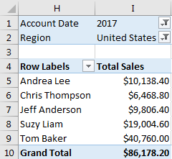
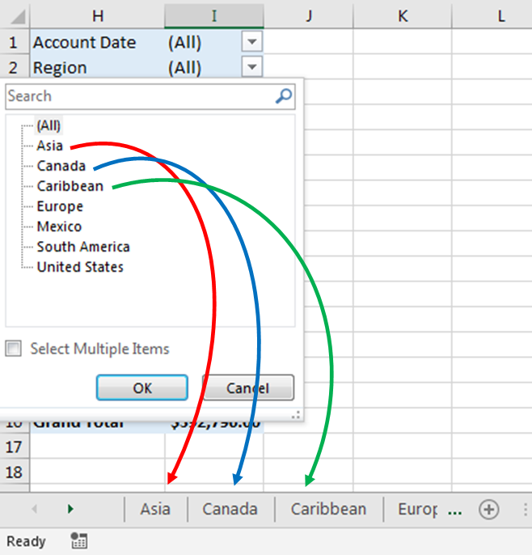
8 – Filtering Pivot Tables
Concepts: Using Report Filters
You can create reports to summarize and analyse specific parts of the data set by
  Adding report filters to display selected items in a pivot table.
  Using the Show Report Filter Pages feature to generate separate reports for each item selected.
Using the Show Report Filter Pages
Using Account Date and Region Report Filters
Notes:
Instructor notes:
Cover content in learning materials
References:
ICDL Data Analytics - Foundation 1.0 (8.1 Using Report Filters)
Further Resources:

Slide 40
8 – Filtering Pivot Tables
Task: Use the report filter.
Example: Add report filters for the Account Date and Region fields
Steps:
Open the Sales Report.xlsx workbook.
Click on any cell in the pivot table.
Move the Account Date field from the Columns area to the Filters area.
Drag and drop the Region field to the Filters area.
Notes:
Instructor notes:
Cover content in learning materials
References:
ICDL Data Analytics - Foundation 1.0 (8.1 Using Report Filters)
Further Resources:

Slide 41
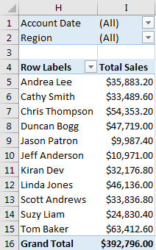
8 – Filtering Pivot Tables
Task: Use the report filter.
Example: Add report filters for the Account Date and Region fields.
Result:
Report filters (Account Date and Region) appear above the pivot table
Notes:
Instructor notes:
Cover content in learning materials
References:
ICDL Data Analytics - Foundation 1.0 (8.1 Using Report Filters)
Further Resources:

Slide 42
8 – Filtering Pivot Tables
Task: Use the report filter.
Example: Use report filters to view summary data for the United States in the year 2017.
Steps:
Select the year 2017 from the Account Date drop-down list and click OK.
Select the region United States from the Region drop-down list and click OK.
Notes:
Instructor notes:
Cover content in learning materials
References:
ICDL Data Analytics - Foundation 1.0 (8.1 Using Report Filters)
Further Resources:

Slide 43
8 – Filtering Pivot Tables
Task: Use the report filter.
Example: Use the report filters to view summary data for the United States in the year 2017.
Result:
Report filters applied
Notes:
Instructor notes:
Cover content in learning materials
References:
ICDL Data Analytics - Foundation 1.0 (8.1 Using Report Filters)
Further Resources:

Slide 44
8 – Filtering Pivot Tables
Task: Use the report filter.
Example: Clear report filters from the pivot table
Steps:
Select All from the Account Date drop-down list and click OK.
Select All from the Region drop-down list and click OK.
To remove the report filters from the pivot table, remove the fields from the Filters area.
Notes:
Instructor notes:
Cover content in learning materials
References:
ICDL Data Analytics - Foundation 1.0 (8.1 Using Report Filters)
Further Resources:

Slide 45
8 – Filtering Pivot Tables
Task: Use the report filter.
Example: Clear report filters from the pivot table.
Result:
Report filters cleared
Notes:
Instructor notes:
Cover content in learning materials
References:
ICDL Data Analytics - Foundation 1.0 (8.1 Using Report Filters)
Further Resources:

Slide 46
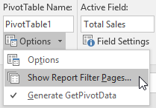
8 – Filtering Pivot Tables
Task: Use the report filter.
Example: Use the Show Report Filter Pages feature to create reports for all the regions.
Steps:
Click on any cell in the pivot table (with report filters applied).
On the Analyze tab, in the PivotTable group, click Options down-pointing arrow, and click Show Report Filter Pages.
Select Region and click OK.
Notes:
Instructor notes:
Cover content in learning materials
References:
ICDL Data Analytics - Foundation 1.0 (8.1 Using Report Filters)
Further Resources:

Slide 47
8 – Filtering Pivot Tables
Task: Use the report filter.
Example: Use the Show Report Filter Pages feature to create reports for all the regions.
Result:
New Worksheets Created for Each Region
Notes:
Instructor notes:
Cover content in learning materials
References:
ICDL Data Analytics - Foundation 1.0 (8.1 Using Report Filters)
Further Resources:

Slide 48

8 – Filtering Pivot Tables
Concepts: Using pivot table slicers.
You can add slicers to quickly and easily filter pivot table data and make reports interactive.
You can customise slicers.
You can also connect a slicer to multiple pivot tables ( with the same source data) to create cross-filtered reports.
A pivot table slicer
Notes:
Instructor notes:
Cover content in learning materials
References:
ICDL Data Analytics - Foundation 1.0 (8.2 Using Pivot Table Slicers)
Further Resources:

Slide 49
8 – Filtering Pivot Tables
Task: Insert and use slicers to filter single pivot tables.
Example: Create a slicer to view summary data by Area.
Steps:
Open Pivot Slicers.xlsx and go to the Slicer1 worksheet.
Click on any value in the pivot table.
On the Analyze tab, in the Filter group, click Insert Slicer.
Select the relevant field, in this case Area and click OK.
Click and drag the slicer to position it, for example, to the right of the pivot table. Resize the slicer as necessary using the sizing handles.
Use the slicer to filter the pivot table by doing one of the following:
  To select a single item, click the item button.
  To select multiple contiguous items, click the first item button, press SHIFT, and click the last item button.
  To select multiple non-contiguous items, press CTRL and click on the item buttons.
Click the Clear Filter icon at the top right of the slicer to clear the filter.
Notes:
Instructor notes:
Cover content in learning materials
References:
ICDL Data Analytics - Foundation 1.0 (8.2 Using Pivot Table Slicers)
Further Resources:

Slide 50
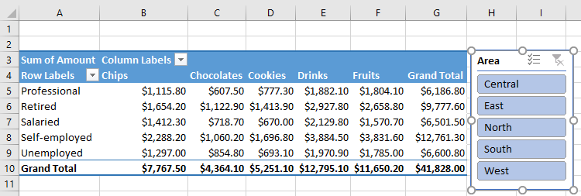
8 – Filtering Pivot Tables
Task: Insert and use slicers to filter single pivot tables.
Example: Create a slicer to view summary data by Area.
Result:
The slicer appears on the worksheet alongside the PivotTable
Notes:
Instructor notes:
Cover content in learning materials
References:
ICDL Data Analytics - Foundation 1.0 (8.2 Using Pivot Table Slicers)
Further Resources:

Slide 51
8 – Filtering Pivot Tables
Task: Insert and use slicers to filter single pivot tables.
Example: Format the Area slicer.
Steps:
On the Options tab, in the Slicer group, click Slicer Settings.
Change the Slicer’s Name and display options for Header and Item Sorting and Filtering if required.
On the Options tab, in the Slicer Styles group, select a style for the slicer – in this case Light Orange, Slicer Style Light 2.
On the Options tab, in the Buttons group, select the number of columns – in this case, type 5 in the Columns box, and change the button height and width as necessary.
To ensure all the buttons are visible, on the Options tab, in the Size group, change the overall size of the slicer height and width as necessary.
To delete a slicer, click on the slicer to select it, and press Delete. Or right-click the slicer and select Remove <Name of Slicer> from the context menu
Notes:
Instructor notes:
Cover content in learning materials
References:
ICDL Data Analytics - Foundation 1.0 (8.2 Using Pivot Table Slicers)
Further Resources:

Slide 52
8 – Filtering Pivot Tables
Task: Insert and use slicers to filter single pivot tables.
Example: Format the Area slicer.
Result:
The slicer style is changed to light orange and the number of columns is changed from 1 to 5.
Notes:
Instructor notes:
Cover content in learning materials
References:
ICDL Data Analytics - Foundation 1.0 (8.2 Using Pivot Table Slicers)
Further Resources:

Slide 53
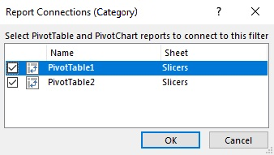
8 – Filtering Pivot Tables
Task: Insert and use slicers to filter single pivot tables.
Example: Connect slicers across pivot tables.
Steps:
Open the Share Slicers.xlsx workbook and go to the Slicers worksheet.
Select the Profession slicer next to the top pivot table.
On the Options tab, in the Slicer group, click Report Connections.
In the Report Connections dialog box, check the option for PivotTable2 to link the Profession slicer to the bottom pivot table
Click OK.
Repeat steps 3 and 4 to connect the
Category slicer to the top pivot table
(PivotTable1).
Notes:
Instructor notes:
Cover content in learning materials
References:
ICDL Data Analytics - Foundation 1.0 (8.2 Using Pivot Table Slicers)
Further Resources:

Slide 54
8 – Filtering Pivot Tables
Task: Insert and use slicers to filter single pivot tables.
Example: Connect slicers across pivot tables.
Result:
The slicers (Profession and Category) are connected to both pivot tables.
Making a selection in either slicer filters the data in both pivot tables accordingly.
Notes:
Instructor notes:
Cover content in learning materials
References:
ICDL Data Analytics - Foundation 1.0 (8.2 Using Pivot Table Slicers)
Further Resources:

Slide 55
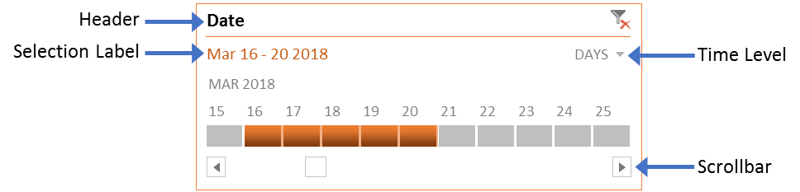
8 – Filtering Pivot Tables
Concepts: Using Timelines.
You can use the Timeline option to display data in a pivot table for different time periods:
  Years
  Quarters
  Months
  Days
The pivot table needs to include at least one date-formatted field.
You can use one Timeline to filter multiple pivot tables with the same data source.
Notes:
Instructor notes:
Cover content in learning materials
References:
ICDL Data Analytics - Foundation 1.0 (8.3 Using Timelines)
Further Resources:

Slide 56
8 – Filtering Pivot Tables
Task: Insert and filter a Timeline.
Example: Create a Timeline and view summary data for the time period 16th to 20th March.
Steps:
Open the Timeline.xlsx workbook and go to the Pivot worksheet.
Select any value in the first pivot table in the worksheet.
On the Analyze tab, in the Filter group, click Insert Timeline.
In the Insert Timelines dialog box select the date-formatted field on which to base the timeline – in this case, click Date and click OK.
Click and drag the timeline to place it above the PivotTable.
Click the arrow next to the time level shown and select DAYS.
Drag the Timeline scroll bar to 15th March.
Click the tiles for 16th to 20th Mar.
Notes:
Instructor notes:
Cover content in learning materials
References:
ICDL Data Analytics - Foundation 1.0 (8.3 Using Timelines)
Further Resources:

Slide 57
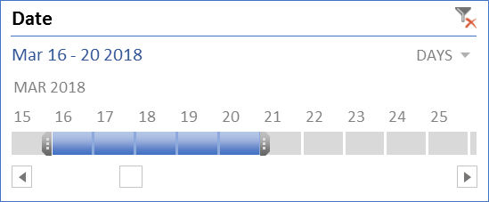
8 – Filtering Pivot Tables
Task: Insert and filter a Timeline
Example: Create a Timeline and view summary data for the time period 16th to 20th March.
Result:
Adjusting the Date Range
Notes:
Instructor notes:
Cover content in learning materials
References:
ICDL Data Analytics - Foundation 1.0 (8.3 Using Timelines)
Further Resources:

Slide 58

8 – Filtering Pivot Tables
Task: Insert and filter a timeline.
Example: Format the Timeline
Steps:
On the Options tab, in the Timeline Styles group, select a style for the timeline.
On the Options tab, in the Size group, change the overall size of the timeline height and width as required.
On the Options tab, in the Show group, set the options you want to display in the timeline.
Click the Clear Filter icon at the top right of the timeline to clear it.
Select the Timeline and press Delete to delete it.
Select the Timeline and in the Options tab select Report Connections and select the pivot tables to filter multiple pivot tables.
Setting the Show Options
Notes:
Instructor notes:
Cover content in learning materials
References:
ICDL Data Analytics - Foundation 1.0 (8.3 Using Timelines)
Further Resources:

Slide 59
8 – Filtering Pivot Tables
Task: Insert and filter a Timeline.
Example: Format the Timeline.
Result:
Formatted Timeline
Notes:
Instructor notes:
Cover content in learning materials
References:
ICDL Data Analytics - Foundation 1.0 (8.3 Using Timelines)
Further Resources:

Slide 60
8 – Filtering Pivot Tables
Learning Objectives Review
You should now be able to:
Use report filters
Use slicers
Use timelines
Notes:
Instructor notes:
Review Learning Objectives

Slide 61
8 – Filtering Pivot Tables
Review Exercise
Notes:
Instructor notes:
Ask participants to complete the Review Exercise to review their knowledge and practice their skills and support them as required.
They will need access to Excel 2016
Review answers with the group
Question answers
1 - 12 (see Purchases-Solution.xlsx)
References:
ICDL Data Analytics - Foundation 1.0 (8.4 Review Exercise – page 114)
Relevant workfiles in Student folder (Purchases.xlsx and solution file Purchases-Solution.xlsx)

Slide 62
Using Pivot Charts
Lesson 9

Slide 63
9 – Using Pivot Charts
Learning Objectives
After completing this lesson, you should be able to:
Create a pivot chart from a pivot table
Create a pivot chart from data in a table
Notes:
Instructor notes:
Review Learning Objectives

Slide 64
9 – Using Pivot Charts
Concepts: Inserting Pivot Charts from Pivot Tables
You can use Pivot Charts to create data visualizations and display different views of your data.
You can create a pivot chart from
  an existing pivot table report
  a table (in which case a corresponding pivot table is automatically created)
Changing the information displayed in a pivot chart automatically changes the corresponding pivot table, and vice versa.
You can add slicers to a pivot chart.
You can change the chart type and customize the visual display and layout.
Notes:
Instructor notes:
Cover content in learning materials
References:
ICDL Data Analytics - Foundation 1.0 (9.1 Inserting Pivot Charts from Pivot Tables)
Further Resources:

Slide 65
9 – Using Pivot Charts
Task: Insert a pivot chart for an existing pivot table.
Example: Insert a pivot chart based on an existing pivot table report.
Steps:
Open the Regional1.xlsx workbook.
Click on any cell in the pivot table.
On the Analyze tab, in the Tools group, click PivotChart.
In the Insert Chart dialog box, select the chart type – Column is selected be default.
Select Stacked Column and click OK.
Move and resize the chart as necessary.
To move the pivot chart to a different worksheet (or to a Chart sheet), on the Analyze tab in the Actions group, click on Move Chart.
Notes:
Instructor notes:
Cover content in learning materials
References:
ICDL Data Analytics - Foundation 1.0 (9.1 Inserting Pivot Charts from Pivot Tables)
Further Resources:

Slide 66
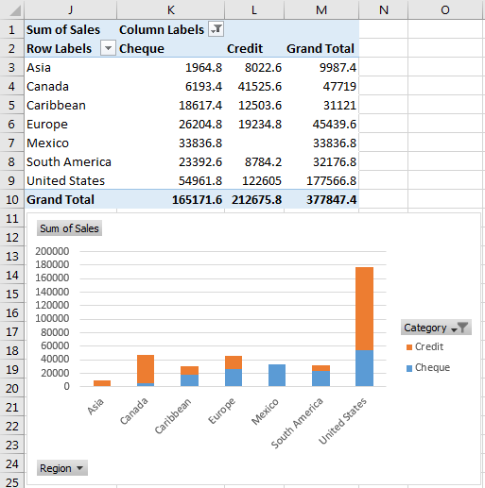
9 – Using Pivot Charts
Task: Insert a pivot chart for an existing pivot table.
Example: Insert a pivot chart based on an existing pivot table report.
Result:
PivotChart created from an Existing PivotTable
Notes:
Instructor notes:
Cover content in learning materials
References:
ICDL Data Analytics - Foundation 1.0 (9.1 Inserting Pivot Charts from Pivot Tables)
Further Resources:

Slide 67
9 – Using Pivot Charts
Task: Insert a pivot chart for an existing pivot table.
Example: Customise the pivot chart.
Steps:
To add a chart title above the chart, click on the PivotChart area and select the Chart Elements button.
Select Chart Title, select Above Chart and enter the title – in this case, enter Credit and Cheque Transactions
In the Field Buttons drop-down menu, in the Show/Hide group, on the Analyze tab deselect Show Axis Field Buttons, Show Legend Field Buttons and Show Value Field Buttons.
To remove gridlines, click on the PivotChart area and select the Chart Elements button
Deselect Gridlines.
To move the legend below the chart title, click on the PivotChart area and select the Chart Elements button.
Hover over Legend and select Top.
Notes:
Instructor notes:
Cover content in learning materials
References:
ICDL Data Analytics - Foundation 1.0 (9.1 Inserting Pivot Charts from Pivot Tables)
Further Resources:

Slide 68
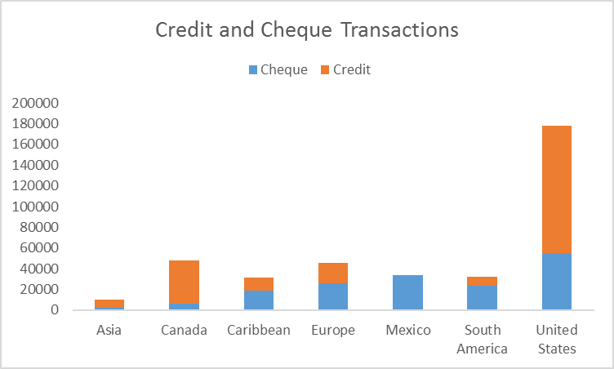
9 – Using Pivot Charts
Task: Insert a pivot chart for an existing pivot table.
Example: Customise the pivot chart.
Result:
Customised Pivot Chart
Notes:
Instructor notes:
Cover content in learning materials
References:
ICDL Data Analytics - Foundation 1.0 (9.1 Inserting Pivot Charts from Pivot Tables)
Further Resources:

Slide 69
9 – Using Pivot Charts
Task: Insert a pivot chart using data set fields in a table.
Example: Insert a pivot chart from a customer sales table.
Steps:
Open the Regional2.xlsx workbook.
Select any cell in the table.
On the Insert tab, in the Charts group, click PivotChart.
In the Create PivotChart dialog box, select the option Existing Worksheet.
Click in the Location box and select cell H4
Click OK.
In the PivotChart Fields pane, drag and drop the fields to the respective areas as follows:
To show each Category as a data series, drag and drop Category to Legend (Series)
To show each Region as a data category on the horizontal axis, drag and drop Region to Axis (Categories)
To show the Sales summary values for each category in each region, drag and drop Sales to Values.
Notes:
Instructor notes:
Cover content in learning materials
References:
ICDL Data Analytics - Foundation 1.0 (9.2 Creating Pivot Charts from Tables)
Further Resources:

Slide 70
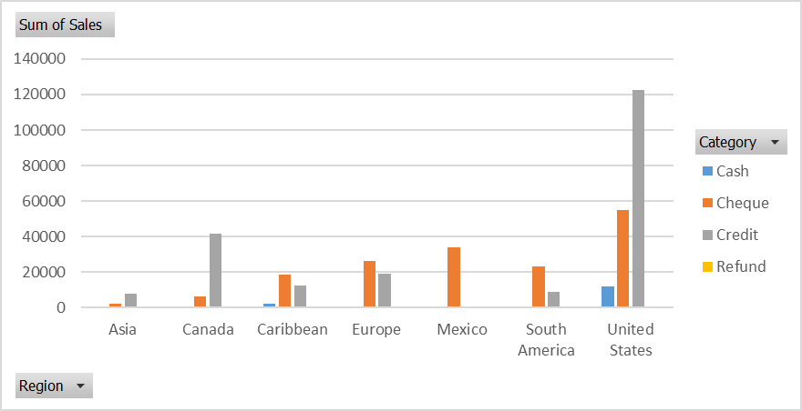
9 – Using Pivot Charts
Task: Insert a pivot chart using data set fields in a table.
Example: Insert a pivot chart from a customer sales table.
Result:
The pivot chart is created using a default chart type (a clustered column chart).
Notes:
Instructor notes:
Cover content in learning materials
References:
ICDL Data Analytics - Foundation 1.0 (9.2 Creating Pivot Charts from Tables)
Further Resources:

Slide 71
9 – Using Pivot Charts
Task: Insert a pivot chart using data set fields in a table.
Example: Customize the pivot chart and add a slicer to view summary data for the Regions.
Steps:
Click Change Chart Type, select Bar and 100% Stacked Bar and click OK.
Move and resize the chart as necessary.
Select the Category field button, deselect Refund and click OK.
Click the PivotChart area, select the Chart Elements button, Chart Title and enter Popular Payment Methods above the chart.
In the Show/Hide group, deselect Show Axis Field Buttons.
Click Insert Slicer in the Filter group, select Region and click OK.
Set the Columns field to 2 in the Buttons group in Options tab.
Move the slicer to the right of the chart and resize.
Click the PivotChart area, select the Chart Styles button, select Style 9.
Click the PivotChart area, select the Chart Styles button, select Color and Colorful Palette 3.
Notes:
Instructor notes:
Cover content in learning materials
References:
ICDL Data Analytics - Foundation 1.0 ((9.2 Creating Pivot Charts from Tables)
Further Resources:

Slide 72
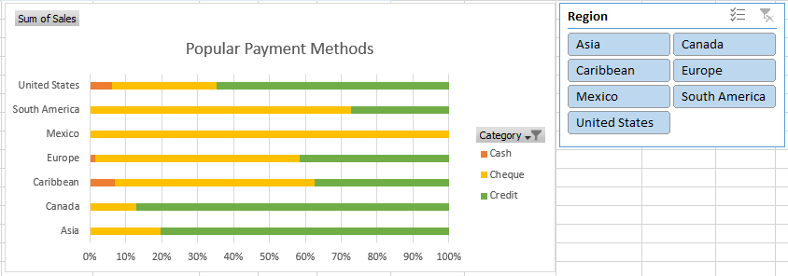
9 – Using Pivot Charts
Task: Insert a pivot chart using data set fields in a table.
Example: Customize the pivot chart and add a slicer to view summary data for the Regions.
Result:
Customized Pivot Chart with Slicer
Notes:
Instructor notes:
Cover content in learning materials
References:
ICDL Data Analytics - Foundation 1.0 (9.2 Creating Pivot Charts from Tables)
Further Resources:

Slide 73
9 – Using Pivot Charts
Learning Objectives Review
You should now be able to:
Create a pivot chart from a pivot table
Create a pivot chart from data in a table
Notes:
Instructor notes:
Review Learning Objectives

Slide 74
9 – Using Pivot Charts
Review Exercise
Notes:
Instructor notes:
Ask participants to complete the Review Exercise to review their knowledge and practice their skills and support them as required.
They will need access to Excel 2016
Review answers with the group
Question answers
1 - 16 (see Personnel-Solution.xlsx)
References:
ICDL Data Analytics - Foundation 1.0 (9. 3Review Exercise – page 129)
Relevant workfiles in Student folder (Personnel.xlsx and solution file Personnel-Solution.xlsx)

Slide 75
3 - Data Set Summarisation
Category Learning Objectives Review
You should now be able to:
Summarise data sets using pivot tables.
Summarise data sets using pivot charts.
Notes:
Instructor notes:
Review session/category level learning objectives

Slide 76

Questions
Notes:
Instructor notes:
Ask participants if they have any questions on this category before moving onto the next category

